Slide 1
Healthcare Capstone Presentation
Business Problem Understanding
Modeling Approach Used & Why
Insights from Analysis
Recommendations

Slide 2
Business Problem Understanding
Business Problem
The objective of this project is to build a model, using data that provides the optimum insurance cost for an individual by using the health and habit-related parameters for the estimated cost of insurance.
Need/study of the project
Analyze relevant data
Define the target variable
Select appropriate modelling techniques
Feature engineering
Model evaluation and Interpretation
Understanding business/social responsibility
Improved risk assessment
More personalized insurance plans
Improved health outcomes
Competitive advantage
Social impact

Slide 3
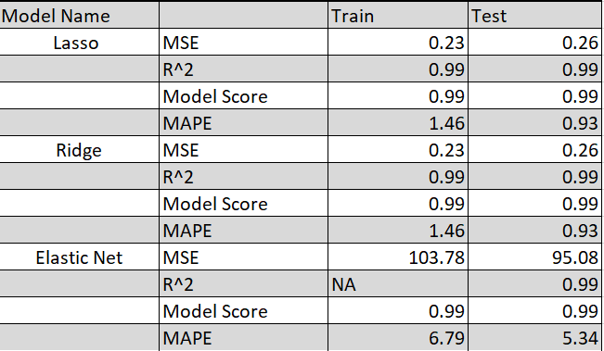
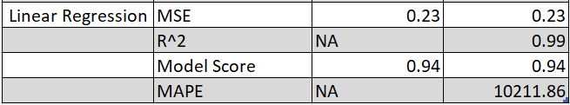
Modelling Approach Used & Why
The modelling approach used here is Regression.
A regression model is a statistical model that estimates the relationship between one dependent variable and one or more independent variables using a line.
Y(target variable) = Insurance cost
Models tried Linear, Lasso, Ridge, and Elastic Net regression models.

Slide 4
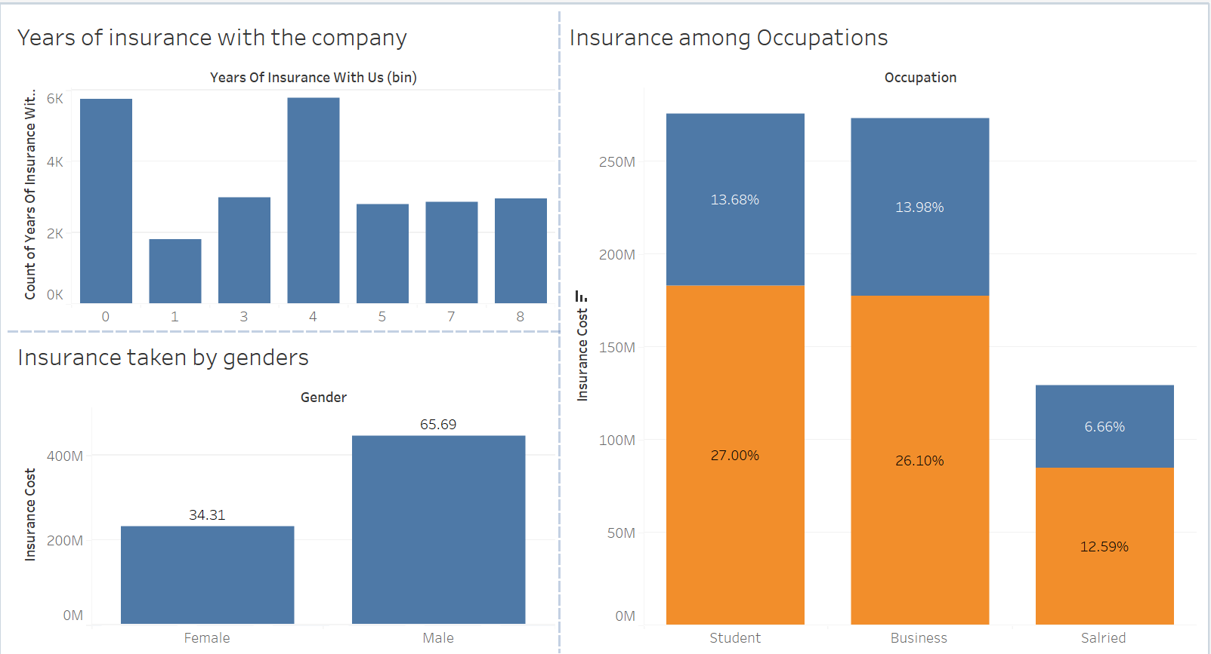
Insights from Analysis
It is seen that the longer duration of insurance with the company for an individual goes up to 8 years. Most people have been with the company for less than a year, but those who have been there for four years make up the majority.
Students are the biggest contributors to the insurance cost, followed by those in the business occupation.

Slide 5
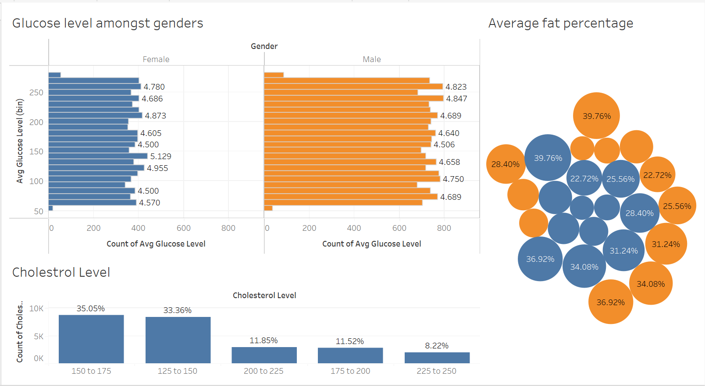
Insights from Analysis
On average, the glucose levels for the majority of males and females fall within a healthy range. However, there are individuals with lower-than-average glucose levels.
79.93% of the population has cholesterol levels within a healthy range. However, a significant proportion of individuals have borderline or high cholesterol levels.
The maximum fat percentage is consistent for both males and females, with a value of 39.76%. However, it is important to consider age when evaluating fat percentage, as this is an age-specific parameter.

Slide 6
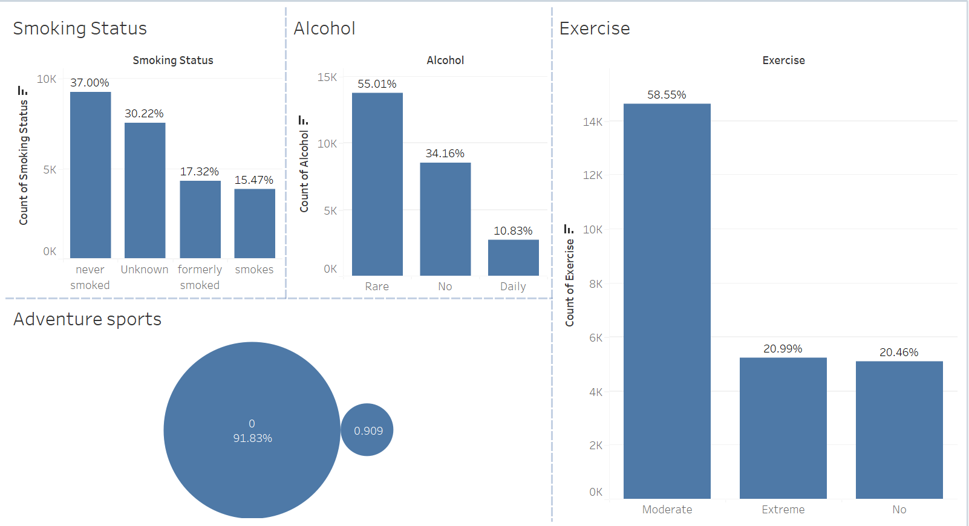
Insights from Analysis
30.22% of the information is not available.
Smaller percentage of the population are daily alcohol consumers.
Additionally, the data reveals that 58.55% of the population engages in moderate exercise.
A significant majority of 91.83% of the population does not participate in any form of adventure sports.

Slide 7
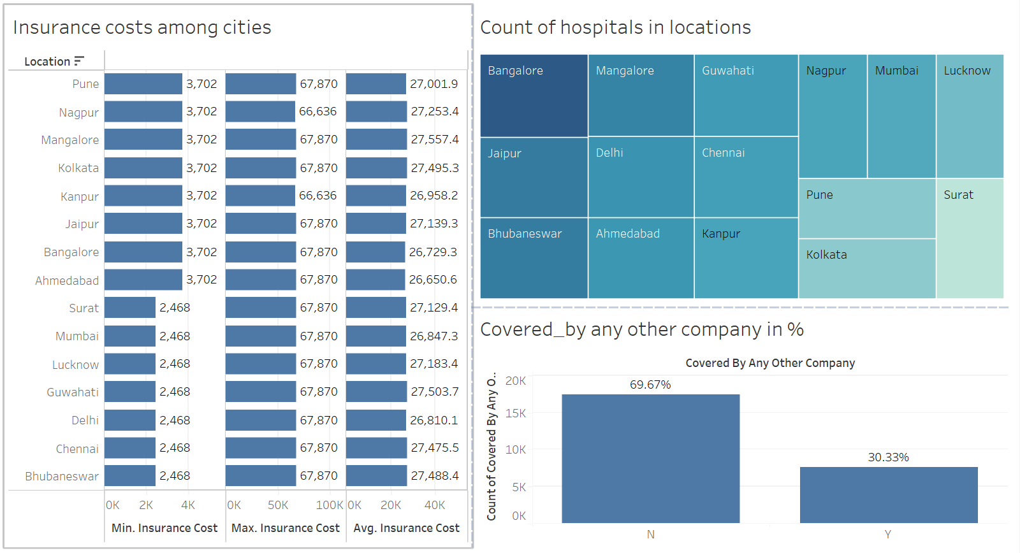
Insights from Analysis
Almost 70% (69.67%) of the individuals associated with the company do not have insurance policies with any other company.
The hospitals in Bangalore, Jaipur, Bhubaneswar, and other cities are in significant numbers, while Pune has fewer hospitals but higher costs associated with it.

Slide 8
Recommendations
Encourage long-term insurance.
Develop tailored products for students.
Target Business Professionals.
Address the one-year-drop-off.
Consult a healthcare professional for glucose, cholesterol & fat percentage levels.
Gather more data for ‘unknowns’.
Promote healthy lifestyle habits & adventure sports.
Conduct research on those individuals who are covered by other companies.
Hospitals in Bangalore, Jaipur, and Bhubaneswar have a significant presence, the company can negotiate with these hospitals to provide better rates to its employees.
The company can consider providing healthcare services such as health check-ups, vaccinations, and wellness programs to its employees to promote a healthier workforce and reduce healthcare costs in the long run.

